Slide 1
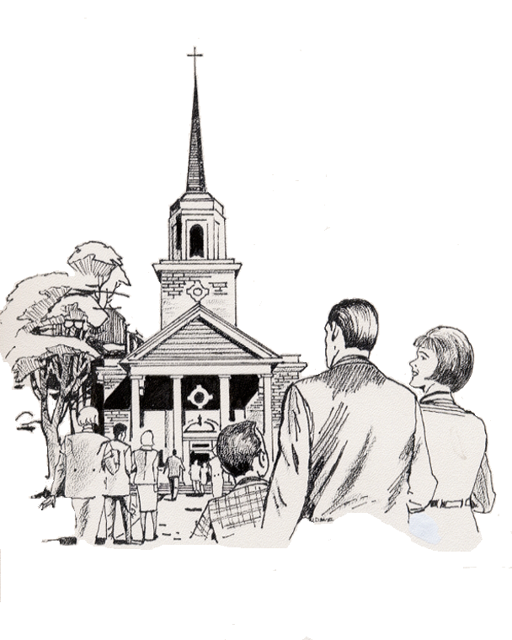

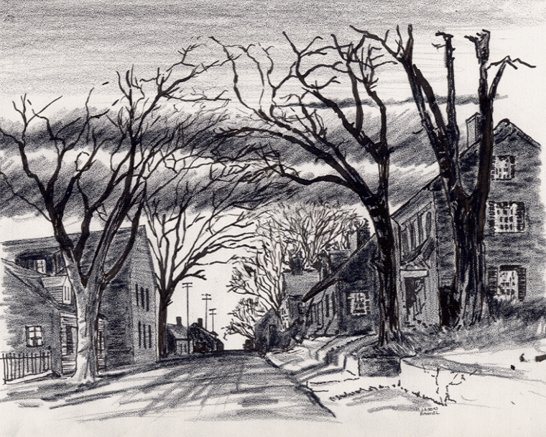
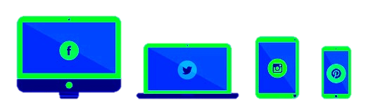

1. My Freelance Individuals Bible Distribution to Families, Friends, Visitors, Co-workers, Businesses, Communities, etc. APP
1-25-2025
Everyone
Everywhere
Any Device
Any Time
Desktop
Laptop
Notebook
Cell Phone
Dallas CLOUD
National Movement Ministries; Grace Technology Not for Profit; Missions & Small Churches Cloud Management, Finance and IT Infrastructure; UsSowinfgSeed.org and B4EE (Bibles 4 Everyone Everywhere; Cloud4Christ.org Missions & Churches Inside and Outside the Walls Ministries and Outreach, Acts 1-8 Worldwide; Cloud4Christ.org Toolbox Development and Information Technology Support; and World -Wide Support Ministries.
1

Slide 2
1. My Freelance Individuals Bible Distribution to Families, Friends, Visitors, Co-workers, Businesses, Communities, etc. APP
Background:
This program, along with our other similar Church Bible Legacy Cloud web Apps have their origins in the fact that Winona, my wife, loved and taught children in public, private and religious organizations for 70 years.
Winona and her husband always had an overwhelming desire to get the word out, particularly to children.
Missions and Churches should also not expect everyone to automatically come to their brick-and-mortar places but make special efforts to get the Word out.
It is also based on the belief that each Christian should fulfill Jesus’ command that they should go into the whole World, meet the World’s needs, encourage all to accept Jesus as their Savior and Lord, and mature in the Faith. The new Christians should serve in the Church, and of course, follow Jesus’ Command to “Get the word out”.
2

Slide 3
1. My Freelance Individuals Bible Distribution to Families, Friends, Visitors, Co-workers, Businesses, Communities, etc. APP
Purpose:
The purpose of this “My Freelance Bible Distribution Web App, UsSowingSeed.org, is to allow any Individual, or Organization, to delivery a Zonderkidz © Children’s Picture Bible to everyone everywhere, using many ways. It is my prayer that many people will respond spontaneously, and in many ways in a Spirit filled way. This is a major way to fulfil Winona’s Bible Distribution Legacy.
Bibles may be provided: 1. To Within the Walls of Churches; to Children, Grandchildren, Friends, Acquaintances, Neighbors, etc.; 2. To People who visit your home; and 3. As you go to work, play, school, shopping, etc. By these activities, many will come to put their faith and trust in Jesus, the true Creator of the universe.
You may use the UsSowingSeed.org Web App that provides Bible purchases and distribution capability. This will allow every Individual, or even Organizations, to effectively perform this very needed task, to change our World for God.
3

Slide 4
1. My Freelance Individuals Bible Distribution to Families, Friends, Visitors, Co-workers, Businesses, Communities, etc. APP
Scope
The scope of “My Freelance” Bible distribution Web App includes:
Handing out free Zonderkidz © Children’s Picture Bibles within and outside the walls of your Mission and Church, as Individual, Group, Team and Organization planned and unplanned opportunities occur. You may use UsSowingSeed.org App, or you may choose the first option App link from B4EE.org App.
Handing out these free Bibles from the trunk of your car, “As-you-go”
Offering these free Bibles as people visit your home
Offering these free Bibles as a part of a home Bible Study
Handing out these free Bibles as children ride your Church bus. etc.
4

Slide 5
1. My Freelance Individuals Bible Distribution to Families, Friends, Visitors, Co-workers, Businesses, Communities, etc. APP
This Program is important because:
There is not enough time to allow using just old methods and organizations. A new state-of-the-art Cloud Platform with a Web App must be quickly finished and used now (May 2024). The Church Planting Movement must also continue and be well planned and implemented. This Web App (UsSowingSeed.org) was released July 2024 via www.Cloud4Christ.org Platform and its How-To Instructions. You may Use The UsSowingSeed.org Web App for this task. We need to also effectively use many volunteer laborers, and Social Media.
2. God has been at work over 2000 Years getting Individuals, Groups and Organizations ready for a now End-time push. I believe the older generation will provide required guidance, but I believe the Youth; College and University Students, and the Younger Adults must do the heavy lifting.
3. God has purposed each of us; and has called and has placed each of us in our roles.
This new technology is available now to instantaneously allow immediate, and complete integration and proof of Great Commission completion.
God will be glorified when we use all means to fill his Universal Church of living stones, with those believers Jesus has and will grant new life for Eternity.
5

Slide 6
1. My Freelance Individuals Bible Distribution to Families, Friends, Visitors, Co-workers, Businesses, Communities, etc. APP
Three Universal Elements for Missions and Churches:
1. Extraordinary Prayer (Essential to have a dedicated Prayer Team)
2. Abundant Evangelism such as “Choose Your One” Sermon series
3. Authority of God’s Word.
6

Slide 7
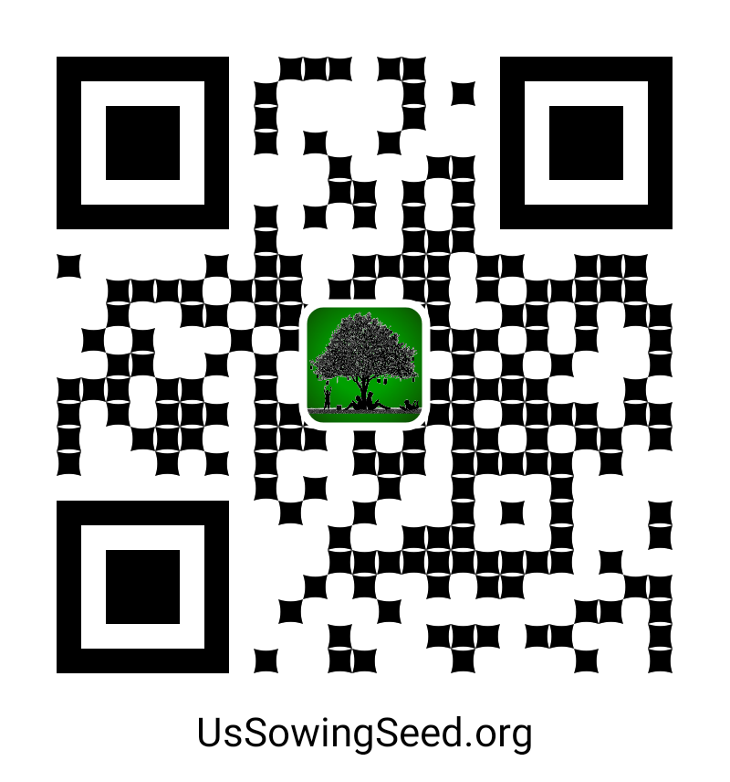
1. My Freelance Individuals Bible Distribution to Families, Friends, Visitors, Co-workers, Businesses, Communities, etc. APP
Here is the Bottom line on how to perform this Cloud4Christ.org Web App no matter how you may find out how to get started, or how you decide to record address residences where you delivered Zonderkitz© Children’s Picture Bibles, as well as other Age Graded Bibles.
1. Log onto UsSowingSeed.Org
2. Select “My Freelance” Designated Distribution and order Bibles for provider mailing or delivery to your home. Then record Bible cost data for tax purposes. You may enter 0’s for costs also.
3. Undeliverable residence Bibles may also be noted due to a vacancy, decision of a person not to accept the Word, etc. May also be added as software is upgraded. When one ends Freelance close App.
7

Slide 8
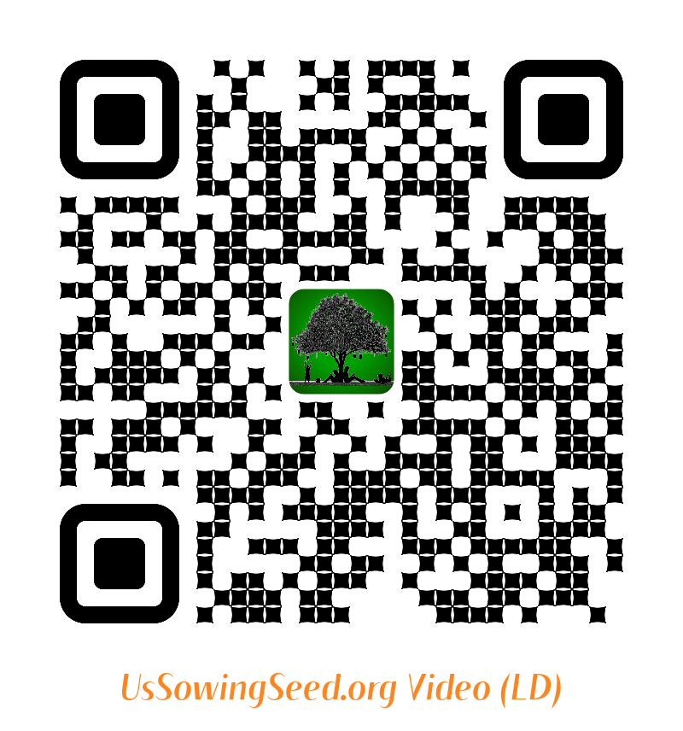
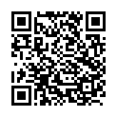
1. My Freelance Individuals Bible Distribution to Families, Friends, Visitors, Co-workers, Businesses, Communites, etc. APP
Use the following QR codes to view the Bible Video, or to Donate.
Video
Video
Become a Cloud4Christ Founder,
and be one of a 1000 $10.00/Month
Contributors.
Donate
General
Use the above QR codes to “Donate to the Non-profit Grace Technology Organization, as a tax-deductible contribution. Note: you may use a Debit Card, Credit Card, Pay Pal, etc.
8

Slide 9
1. My Freelance Individuals Bible Distribution to Families, Friends, Visitors, Co-workers, Businesses, Communities, etc. APP
Tips
Select the residence addresses as follows:
a. Address # on the mail receptacle, if available
b. Address # located on the house, if available
c. “Click’ on the map street location to use the 911 map address (Later capability).
Type in an address for Bible delivery until the complete address appears below in the dropdown list. Must click the address list line, to assure a correct address. A blue Location Pen will be shown on map. Then record delivery. Pen will change to Green, denoting Bible delivered.
When one orders Bibles, click Get Bibles. Search providers data until cheapest cost found. Order and close link.
On return, post purchase data on form for English and Bilingual Bibles purchased. Used for tax purposes. The inventory count of Bibles will be corrected ad displayed.
May use the manual option to reconcile indicated Bible inventory with actual Bibles in your inventory.
9

