Slide 1
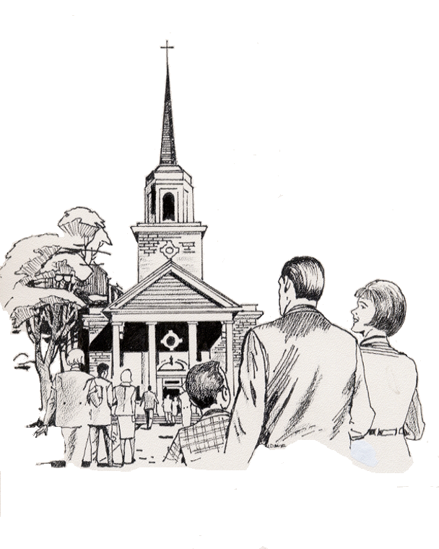

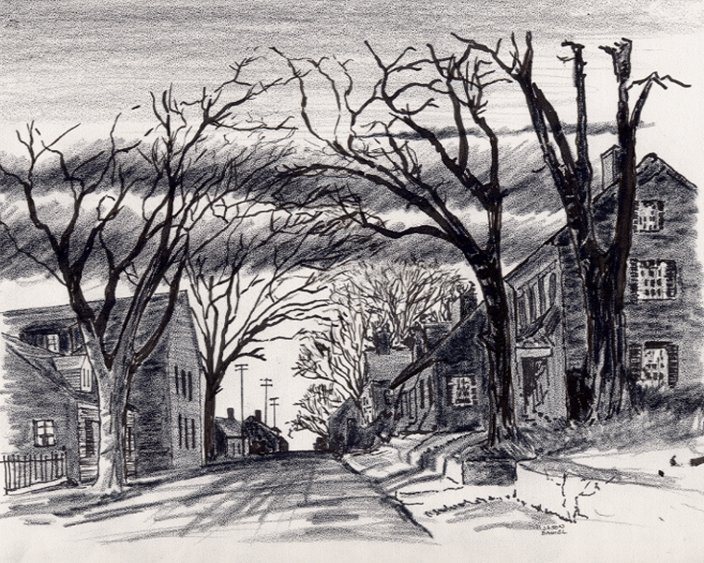

10. “BEE” - Bibles for Everyone Everywhere
1-5-2025
Everyone
Everywhere
Any Device
Dallas CLOUD
Cell Phone
Notebook
Laptop
Desktop
Cloud4Christ Church Inside and Outside the Walls Ministries; National Movement Ministries; World -Wide Support Ministries; Cloud4Christ.org Tools Development and Information Technology Support; Missions & Small Church Cloud Management and IT Infrastructure; UsSowingSeed.org (Winona’s Bible Legacy) and B4EE (Bibles 4 Everyone Everywhere Ministries
1

Slide 2
10. “BEE” - Bibles for Everyone Everywhere
Background:
This program, along with our ten other similar Church Bible Legacy Cloud Programs and Apps have their origins in the fact that Winona, my wife; loved and taught children in public, private and religious organizations for 70 years.
Winona and her husband always had an overwhelming desire to get the word out, particularly to children.
Missions and Churches should also not expect everyone to automatically come to their brick-and-mortar Churches.
Bible distribution is also based on the belief that each Mission and Church Member should fulfill Jesus’ command that they should: Go into the whole World, Meet the World’s needs, Encourage all to accept Jesus as their Savior and Lord, and Mature in the Faith. New Christians should serve in the Church, and of course, follow Jesus’ Command to “Get the word out”.
2

Slide 3
10. “BEE” - Bibles for Everyone Everywhere
Purpose:
The purpose of this BEE Program is to provide and fund a capability that will ensure 3-4 Types of Bibles will be distributed Inside and Outside the Walls of each Mission and Church in the U.SA., as needed. A supportive Cloud4Christ.org “B4EE.org”, Bibles for Everyone Everywhere, is also provided. Activities should occur, and funds should be provided for World ministries also.
1. A Zonderkidz © Children’s New Beginners English or Bilingual Picture Bible will be distributed first to each residence. within the U. S. A. in 3 years by a link to UsSowingSeed.org app, from within B4EE.org.
2. Deliver three to four additional age-graded Bibles via B4EE.org to each Mission and Church within the Church Walls; and outside the Church Walls “Jerusalem” Radius Area, “Judea” County Area, “Samaria” Region Area, and “Samaria” State Areas (All 52 States. And then to the World.
3. Obtain needed Bibles from organizations such as American Bible Society, Grace Technology.org (when available), Amazon, Bibles in Bulk, via B4EE.org App links.
4. Help Everyone Everywhere who receives a Bible in the U. S. A. by this activity to put their faith and trust in Jesus, the true Creator of the Universe and the Savior of all people.
3

Slide 4
10. “BEE” - Bibles for Everyone Everywhere
Scope
This “BEE” Program consists of delivering 3-4 Age graded Bibles to every USA resident ASAP. It also provides for distributing of Bibles throughout the World via other Organizations.
1. A Zonderkidz © Children’s New Beginners English or Bilingual Picture Bible will be distributed first to each residence within the U. S. A. in 3 years. The distribution may be accomplished by anyone, anywhere and via a link to UsSowingSeed.org app.
This App Allows: 1. Any individual to use the Freelance Method to randomly or systematically deliver Children’s Bibles as noted above, 2. Any individual or Organization to use Direct mailing of Bibles via a list through a linked distributor or by the App user, Or 3. Any individual or Organization to hand deliver Bibles via a self generated or Group Leader list. Note: The targeted delivery may be a “My Street”, Apartment. Etc.
2. Deliver three to four additional age-graded Bibles via B4EE.org to each Mission and Church within the Church Walls; and outside the Church Walls “Jerusalem” Radius Area, “Judea” County Area, “Samaria” Region Area, and “Samaria” State Areas (All 52 States).
3. Plan and schedule Delivery of Bibles or funds outside the U.S.A.
4

Slide 5
10. “BEE” - Bibles for Everyone Everywhere
The Program is important because:
There is not enough time to allow using just old methods and organizations. A new state-of-the-art Cloud Platform with a downloadable Web App must be quickly finished and used. Some of the required tools are now available with others coming available soon via www.Cloud4Christ.org Platform.
God has been at work over 2000 Years getting Individuals, Groups and Organizations ready for His just begun End-time push
God has purposed each of us; and has called and has placed each of us in our roles.
This new technology is needed now to instantaneously allow immediate and complete integration and proof of Great Commission completion.
5

Slide 6
10. “BEE” - Bibles for Everyone Everywhere
Seven Universal Elements for Churches/Missions:
1. Extraordinary Prayer (Essential to have a dedicated Prayer Team)
2. Abundant Evangelism such as “Choose Your One”
Intentional Priorities given to all types of Bible distribution
Authority of God’s Word
Identify, Disciple and Train all Church Members
6

Slide 7
10. “BEE” - Bibles for Everyone Everywhere
Seven Universal Elements for Churches/Missions: - Continued
6. Provide Zonderkidz Picture Bibles in Organization entrances and Storefronts to allow easy delivery to Kg-6th grade children.
7. Maintain stock of Bibles to meet all needs, and record Bible deliveries in above Cloud Apps.
7

Slide 8
10. “BEE” - Bibles for Everyone Everywhere
Organization Needs
1. Organization Administrator
2. “BEE App Leader.
3. Bible Purchaser, and Inventory Manager.
4. Volunteer Bible Deliverer Individuals.
5. UsSowingSeed.org App Bible delivery status technician.
Note: Each Bible deliverer will keep record of each address serviced, and periodically provide to the above technician.
8

Slide 9
10. “BEE” - Bibles for Everyone Everywhere
Here is the Bottom line on how to perform this BEE Program and complementary Cloud4Christ.org B4EE.org Web App.
1. Assign an Organization Administrator, if not already available
2. The Organization Administrator assigns a BEE App Leader
3. Establish a Mission or Church Designated BEE fund
4. Conduct fund raisers or provide “free” Biles
5. Obtain needed Bibles from organizations such as American Bible Society, Grace Technology.org (when available), Amazon, Bibles in Bulk, via B4EE.org App links, etc.
6. Deliver Age graded Bibles to People, Organizations or Specialized Bible Distributors as follows:
a. Deliver a Zonderkidz © Children’s Picture Bible to all ~ 160,000,000 (Million) residences in the USA in 3 years. Emphasis is to first deliver this specific Zonderkids Children’ Picture Bible (English or Bilingual) within and outside each Mission and Church Walls via the UsSowingSeed.org or B4EE.org Cloud4Christ.org Cloud Web site Apps.
b. Deliver three to four additional age-graded Bibles via B4EE.org to each Mission and Church within the Church Walls; and outside the Church Walls “Jerusalem” Radius Area, etc..
c. Plan and schedule Delivery of Bibles or funds to outside the USA People or Organizations .
9

Slide 10
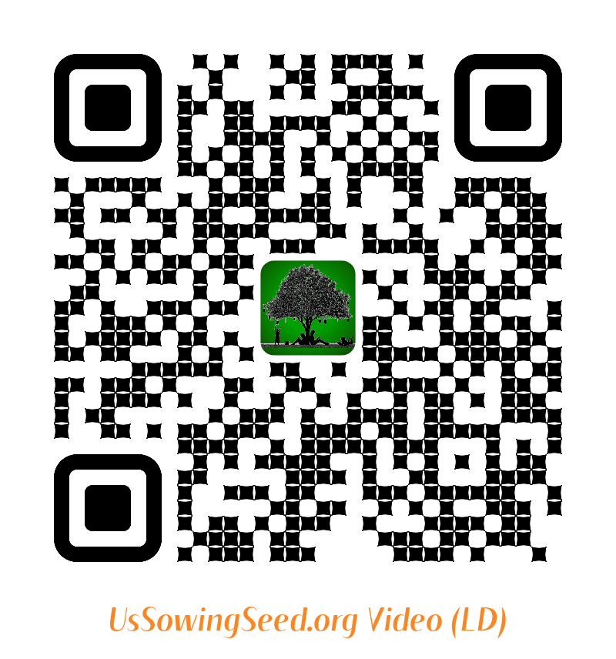
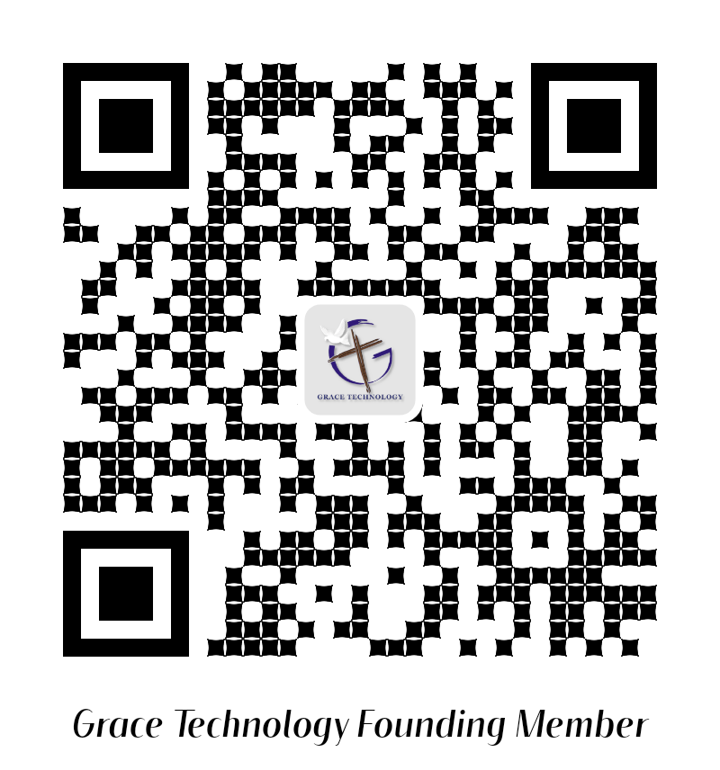
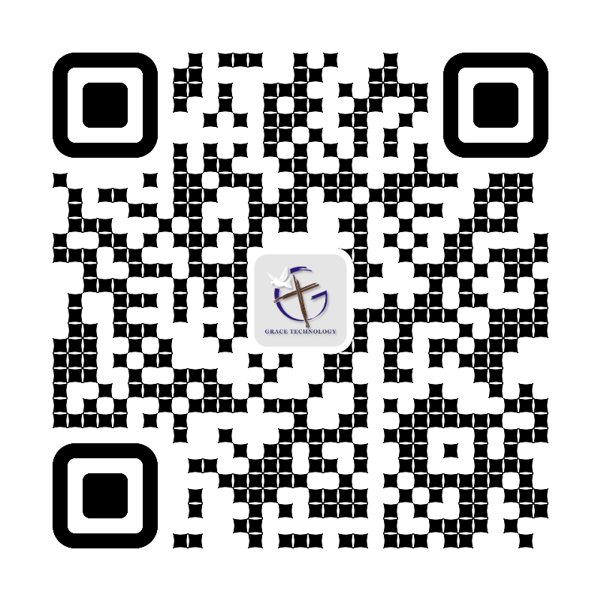
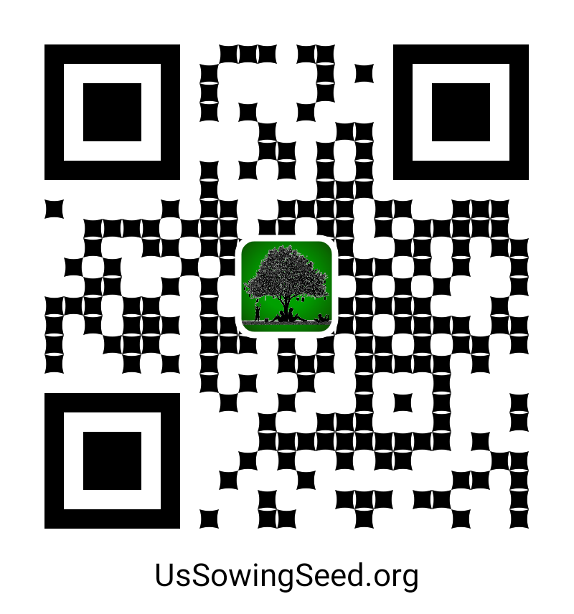
Use the following QR codes to view the Bible Video, or to Donate.
Become a Cloud4Christ Founder,
Video and be one of a 1000 $10.00/Month
Contributors.
Donate UsSowingSeed.org
General
Use the above QR codes to “Donate to the Non-profit Grace Technology Organization, as a tax-deductible contribution. Note: you may use a Debit Card, Credit Card, Pay Pal, etc.
10

