Slide 1


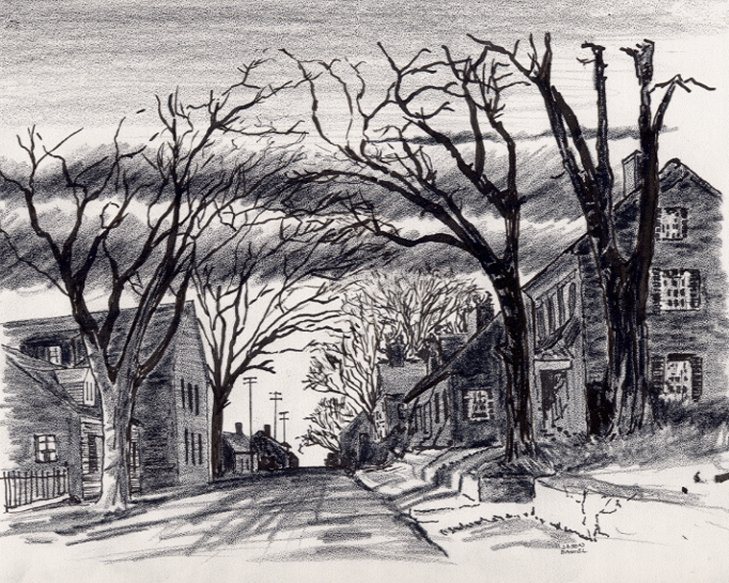


11. “My Pass It On Bible Web App©
1-5-2025
Everyone
Everywhere
Any Device
Any Time
Desktop
Laptop
Notebook
Cell Phone
Dallas CLOUD
1

Slide 2
11. “My Pass It On Bible Web App©
Background:
This program, along with our ten other similar Church Bible Legacy Cloud Web Store Apps have their origins in the fact that Winona, my wife, loved and taught children in public, private and religious organizations for 70 years.
Winona and her husband always had an overwhelming desire to get the word out, particularly to children.
Missions and Churches should also not expect everyone to automatically come to their brick-and-mortar Missions and Churches.
It is also based on the belief that each Church Member should fulfill Jesus’ command that they should go into the whole World and meet the World’s needs and encourage all to accept Jesus as their Savior and Lord. New Christians should serve in the Church, and of course, follow Jesus’ Command to “Get the word out”.
2

Slide 3
11. “My Pass It On Bible Web App©
Purpose:
The purpose of this Church Bible Distribution Project is to ensure that every child from Kindergarten thru 6th grade in the USA receive a personal Zonderkidz Picture Bible via delivery of one Bible to each residence. This Project encourages Children who have the fortune to possess one of these Bibles will obtain extra Bibles and pass them on to their friends. A child may even pass theirs on to a sibling or someone else, at a convenient time.
Our prayer is that older Children, Parents and Grandparents will help the children by reading and discussing the stories with the children. By this activity, many will come to put their faith and trust in Jesus, the True Creator of the universe.
3

Slide 4
11. “My Pass It On Bible Web App©
Scope
This “Pass it On” Bible Distribution Project encourages current owners of a Children’s Bible to pass theirs on to another at a convenient time.
This App also encourages those Children with a Zonderkidz Picture Bible to obtain additional copies via, UsSowsingSeed.org, or from an appropriate Christian Organization or Individual and give to a friend, etc..
This App also encourages individuals or Organizations to make a list of residences who have been given one or more Zonderkidz Picture Bible to, say, Mail or hand deliver two extra copies of the above Bible to the residences so they may pass them on to their friends. Our UsSowingSeed.org App may be used to generate the list and record the gifts.
4

Slide 5
11. “My Pass It On Bible Web App©
The Program is important because:
There is not enough time to allow even children to sit idly by and let our generation continue to disintegrate. We need to effectively use more laborers, social media, and the Cloud4Christ.org ~29 Web Apps.
God has been at work over 2000 Years getting us ready to accept this God just provided end-time push.
God has purposed each of us and has called and has placed each of us in our roles.
God will be glorified when we use all means to fill his Universal Church, with those believers Jesus has and will grant new life for Eternity.
5

Slide 6
11. “My Pass It On” Individual Zonderkidz Children’s Picture Bible Distribution App©
Five Universal Elements for Churches/Missions:
Extraordinary Prayer
Abundant Evangelism such as “Choose Your One”
Intentional Plans to distribute God’s Word
Authority of God’s Word
Help others spread the Good News.
6

