Slide 1
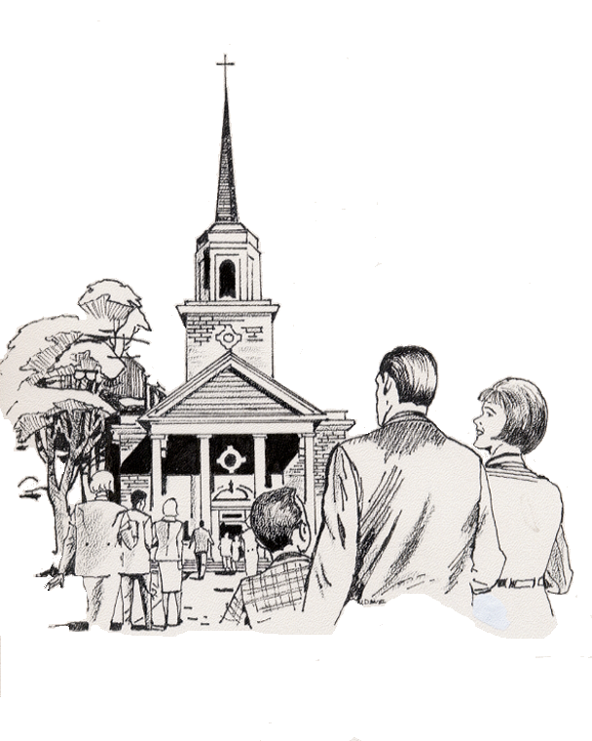

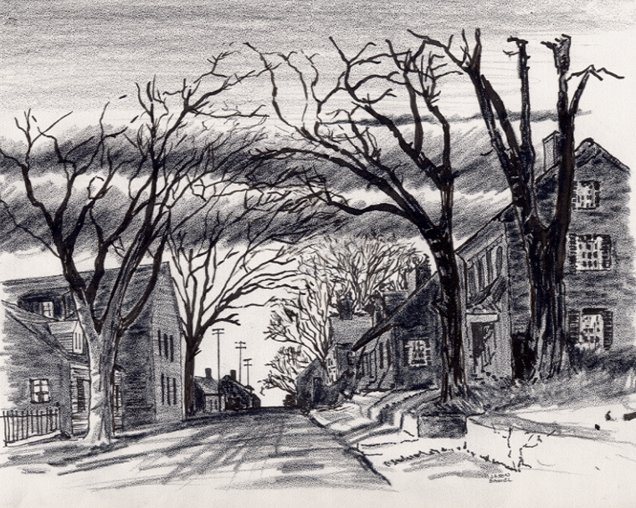


8. My Organization “To The Uttermost Parts of the Earth” (Nations of the World) Ministries & Outreach How-To Instruction & App
1-5-2025
Everyone
Everywhere
Any Device
Any Time
Desktop
Laptop
Notebook
Cell Phone
Dallas CLOUD
National Movement Ministries; Grace Technology Not for Profit; Missions & Small Churches Cloud Management, Finance and IT Infrastructure; UsSowinfgSeed.org and B4EE (Bibles 4 Everyone Everywhere; Cloud4Christ.org Missions & Churches Inside and Outside the Walls Ministries and Outreach, Acts 1-8 Worldwide; Cloud4Christ.org Toolbox Development and Information Technology Support; and World -Wide Support Ministries.
1

Slide 2
8. My Organization “To The Uttermost Parts of the Earth” (Nations of the World) Ministries & Outreach How-To Instruction & App
Background:
This program, along with our other similar Mission and Church Bible Legacy Cloud How-To Instructions and Apps have their origins in the fact that Winona, my wife, loved and taught children in public, private and religious organizations for 70 years.
Winona and her husband always had an overwhelming desire to get the word out, particularly to children.
Missions and Churches, Associations, State Regions, States, Nation, International Missions Boards and Volunteer Christian Groups should not expect everyone to automatically come to their brick-and-mortar Missions and Churches. Acts 1:8 says go! The World, is the sixth of six places to go and spread the Good News.
It is also based on the belief that each Christian should fulfill Jesus’ command that they should go into the whole World, starting at “Jerusalem”, Then to “Judea”, “Samaria”, and the “The Uttermost Parts of the Earth”. All Community and Family needs should be met. Matthew 28:19-20 provides us our command, including encouraging each and all individuals to accept Jesus as their Savior and Lord. The new Christians should serve in the Church, and of course, follow Jesus’ Command to “Get the word out”.
2

Slide 3
8. My Organization “To The Uttermost Parts of the Earth” (Nations of the World) Ministries & Outreach How-To Instruction & App
Purpose:
The purpose of this “To The Uttermost Parts of the Earth” (Nations of the World) How-To Instruction & App is to deliver 3-4 age graded Bibles to each New and Existing Mission and Church in the World. It is our prayer that current generation Sons and Daughters as Street Stewarts will respond in a Spirit filled way. Other Cloud4Christ.org Web Apps are also available for selection from the Toolbox.
Our prayer is that older children, parents and Grandparents will help the children by reading and discussing the stories with them. By this activity, many will come to put their faith and trust in Jesus, the true Creator of the universe.
3

Slide 4
8. My Organization “To The Uttermost Parts of the Earth” (Nations of the World) Ministries & Outreach How-To Instruction & App
Scope
The scope of this How-To Instruction and associated web Apps is to assure & lead each “Uttermost Parts of the Earth” Mission, Church and other Christian Organizations perform their individual Cloud4Christ.org functions as follows:
1. “4. “Bible Distribution Within the Church Walls” via it’s How-To Instruction and UsSowingSeed.org Web App”
2. Cloud4Christ.org Mission and Small Churches Management, Finance, IT and Organizational Software Apps.
The “To The Uttermost Parts of the Earth” effort will then be to support or engage its surrounding area(s) to impact them for Christ. This Task will Include the following functions:
1. Scout out its surrounding area(s) for opportunities to spread the Gospel.
2. Deliver Children’s and other age graded Bibles and materials
3. Partner with surrounding Missions and Churches to further the Gospel
4. Partner with other National or World Organizations to further the Gospel
5. Use the Cloud4Christ.org Platform, How-To Instructions and Apps.
4

Slide 5
8. My Organization “To The Uttermost Parts of the Earth” (Nations of the World) Ministries & Outreach How-To Instruction App
The Program is important because:
There is not enough time to allow using just old methods and organizations. A new state-of-the-art Cloud Platform with an App must be quickly finished and used now. The Church Planting Movement must also continue and be well planned and implemented. The use of these tools in early 2024 via www.Cloud4Christ Platform is encouraged. How-To Instructions & Web Apps, such as: UsSowingSeed.org and B4EE.org will be an effective way to use more laborers, social media, and the Cloud4Christ.org ~29 Web Apps also.
2. God has been at work over 2000 Years getting Individuals, Groups and Organizations ready our current End-time push. I believe the older generation will provide required guidance, but I believe the Current Families of Adults, Youth; College and University Students, and the Younger Adults must do the heavy lifting.
3. God has purposed each of us; and has called and has placed each of us in our roles.
This new technology is needed now to instantaneously allow immediate, collaborative, and complete integration and proof of Great Commission completion. Log onto UsSowingSeed.org, B4EE.org, when available and sign-up to perform your work on site.
God will be glorified when we use all means to fill his Living Stones Universal Church, with those believers Jesus has and will grant new life for Eternity.
5

Slide 6
8. My Organization “To The Uttermost Parts of the Earth” (Nations of the World) Ministries & Outreach How-To Instruction App
Eleven Universal Elements for Churches/Missions:
1. Extraordinary Prayer (Essential to have a dedicated Prayer Team)
2. Abundant Evangelism such as “Choose Your One”
Intentional Priorities given to Christian “Movement” Organizations and Grace Technology administered ~29 Cloud4Christ.org Platform How-To Instructions, and Web Apps
Authority of God’s Word
Identify and Disciple All possible Mission & Church Members.
6

Slide 7
8. My Organization “To The Uttermost Parts of the Earth” (Nations of the World) Ministries & Outreach How-To Instruction App
Eleven Universal Elements for Churches/Missions - Continued:
6. Place Each dedicated person in Position (s) based on their Gifts, Training and Interests
7. Train All Members for Great Commission Christian “Movement” Work in their Area, and Beyond
8. Saturate your Great Commission Work through Ministry, Fellowship and Evangelism
Assimilate Community People into Church Membership & Ministry - Within the Walls and Outside The Walls of Missions, Churches, Home Groups, etc,.
Monthly Community Advertisement Communications
Giving.
7

Slide 8
8. My Organization “To The Uttermost Parts of the Earth” (Nations of the World) Ministries & Outreach How-To Instruction App
Organization Needs
1. Organization Administrator who then assigns App Administrators and Manages this Activity “To The Uttermost Parts Of The Earth.”
2. App Administrators who select workers and manage their App(s).
8

Slide 9
8. My Organization “To The Uttermost Parts of the Earth” (Nations of the World) Ministries & Outreach How-To Instruction App
2. Ministry organizations and individual Ministry and Volunteer assignees:
a. Deliver a Zonderkidz© Children’s Picture Bible, and 3 to 4 other age graded Bibles to each residence, using the UsSowingSeed.org and B4EE.org Web Bible Distribution Apps.
b. Maintain a prayer list and actively pray for them. Take special needs to the church commissioned Prayer Teams.
c. Perform other Ministry functions such as:
1. Meeting benevolence needs
2. Witnessing
3. Community Outreach and Entertaining Events
Note: Non-Church related groups need to only deliver the Children’s Bible only.
9

Slide 10
8. My Organization “To The Uttermost Parts of the Earth” (Nations of the World) Ministries & Outreach How-To Instruction App
Here is the Bottom line on how to perform this Cloud4Christ.org Web App.
1. Select your “To the Uttermost Parts of the Earth” Village or City where Bibles are to be delivered
2. Select Leaders and Laborers
3. Log onto the UsSowingSeed.org or B4EE.org to
4. Obtain Bibles and deliver to each Village or City residence, as money becomes available. Note: Only Zonderkidz © Children’s Picture Bibles need to be delivered by Churches and Non-Church related Christian groups.
5. Obtain Bibles from available local sources or the above Apps. Select “Get Bibles” to purchase Bibles.
6. Record each residence address where one or more Bibles were delivered.
10

Slide 11
8. My Organization “To The Uttermost Parts of the Earth” (Nations of the World) Ministries & Outreach How-To Instruction App
7. periodically meet with your team to review your Up-To-Date list of possible tasks, prioritize the tasks, schedule each task and perform them in a timely manner.
8. You as the App Administrator will need to coordinate with the sponsoring Church, State, National or World Organization, and participating Church leaders to stay connected and keep them informed of current status.
11

Slide 12
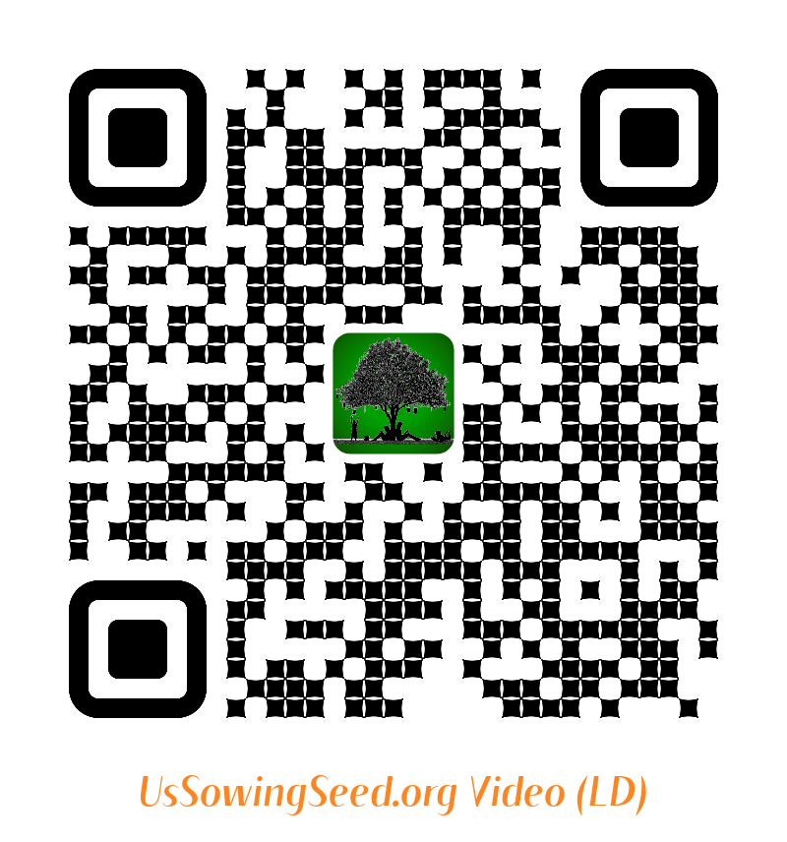
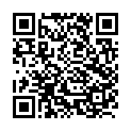
8. My Organization “To The Uttermost Parts of the Earth” (Nations of the World) Ministries & Outreach How-To Instruction App
Use the following QR codes to view the Bible Video, or to Donate.
Video
Video
Become a Cloud4Christ Founder,
and be one of a 1000 $10.00/Month
Contributors.
Donate
General
Use the above QR codes to “Donate to the Non-profit Grace Technology Organization, as a tax-deductible contribution. Note: you may use a Debit Card, Credit Card, Pay Pal, etc.
12

